Slide 1

ETL Project
By: Dennis O’Leary and Michael Padilla

Slide 2
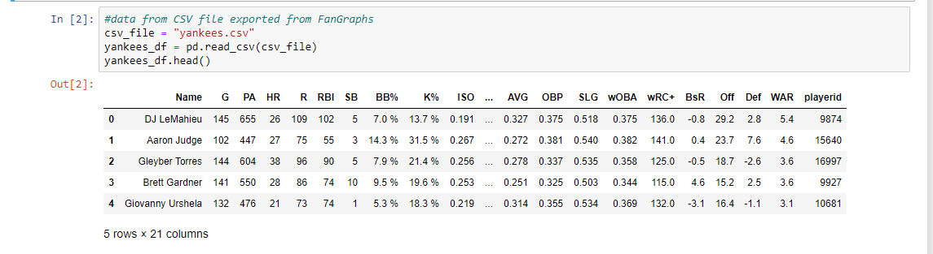
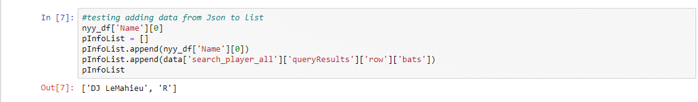
E-Xtraction
Fangraph csv
MLB API
Data Sources:
Fangraphs.com
MLB.com API

Slide 3
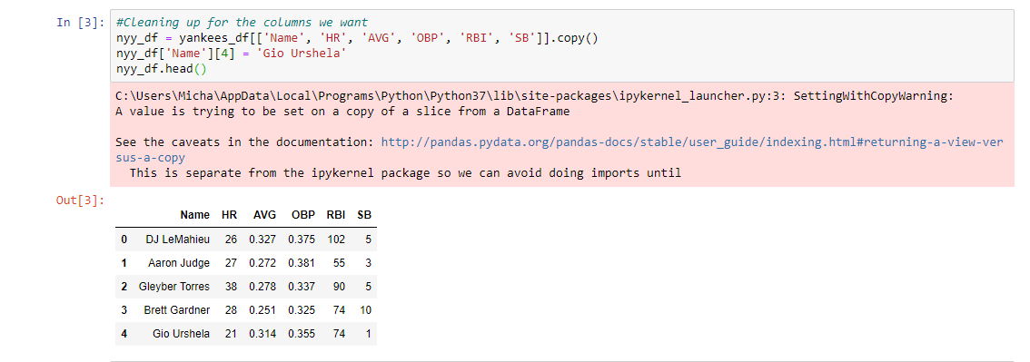
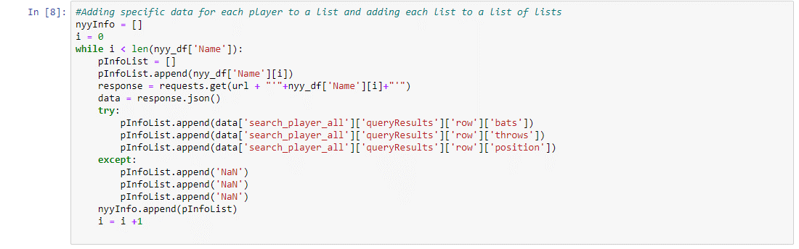
T-Ransform
CSV TO DF
+ Cleaning
API Cleaning
+ Converting

Slide 4
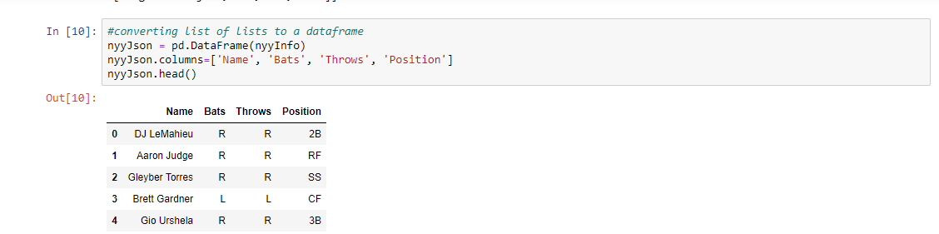
T-Ransform
API TO DF

Slide 5
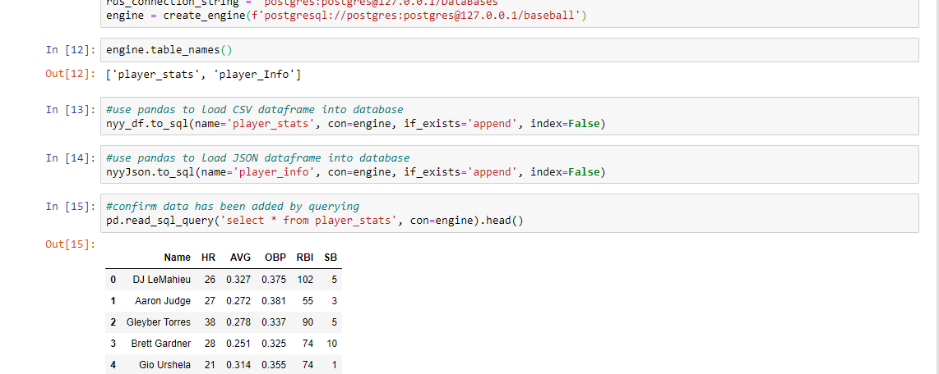
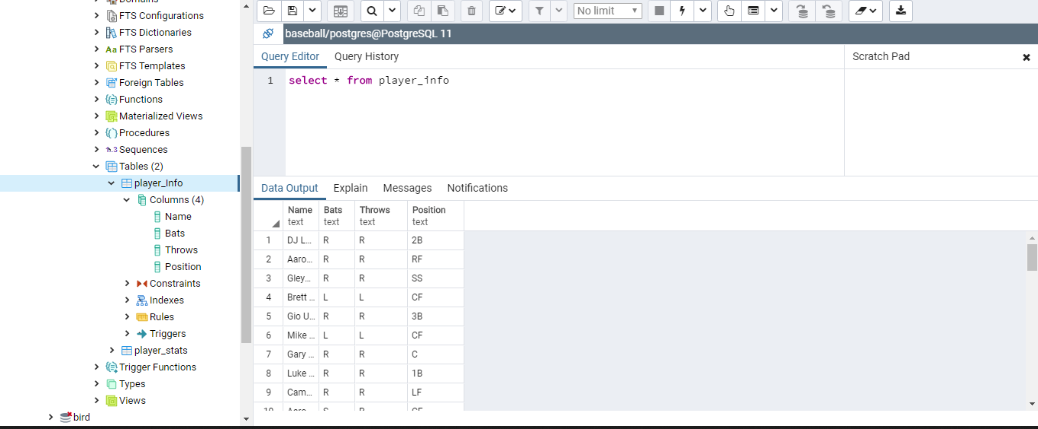
L-oad

Slide 6
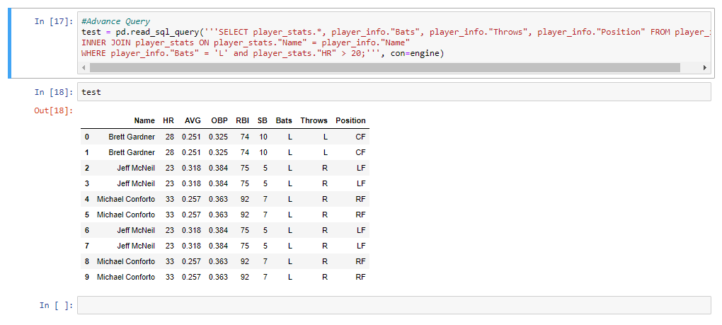
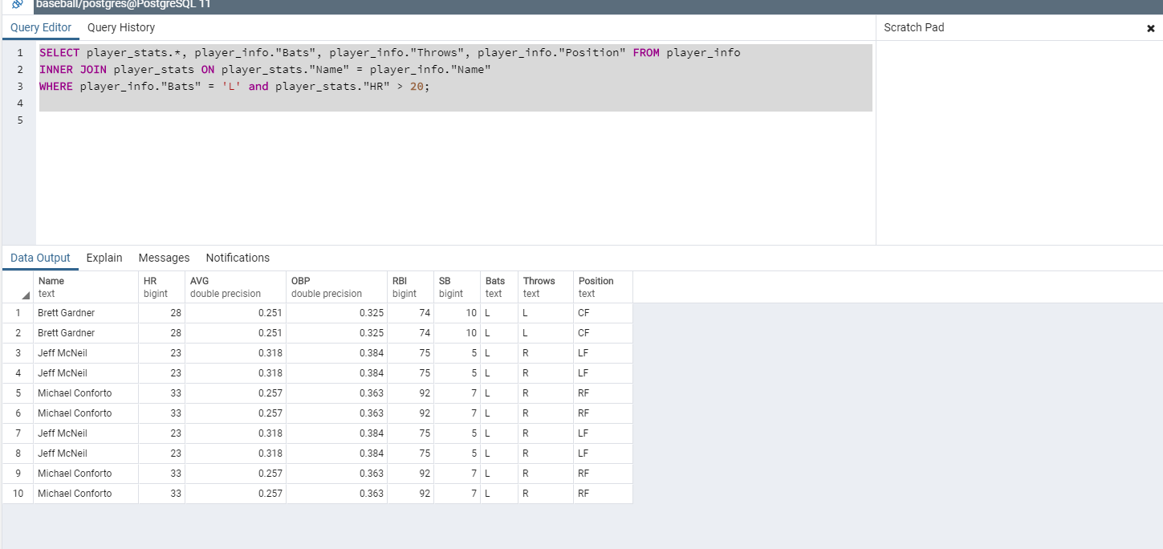
Extra
JOIN and Advance Query

Slide 7
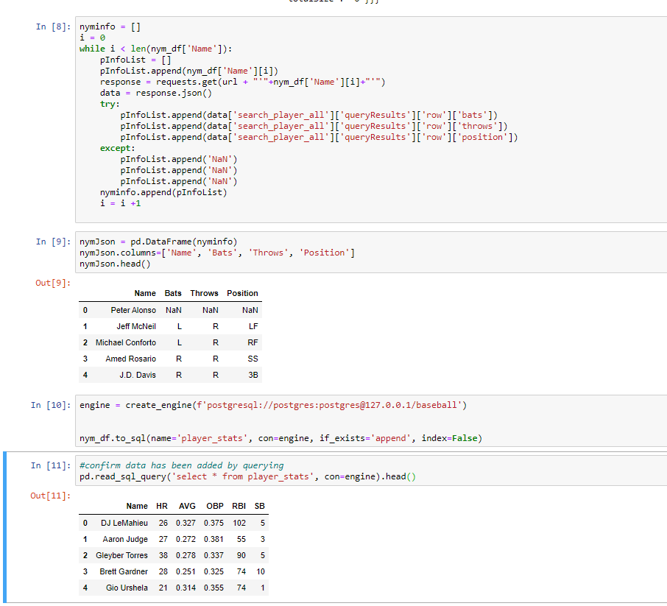
Extra
Adding Two Teams stats to one table
( Second team info ETL then Added to same table)

Slide 8
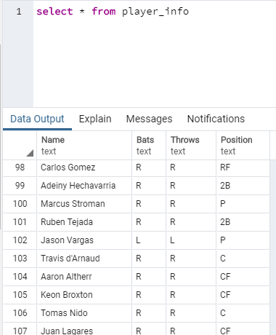
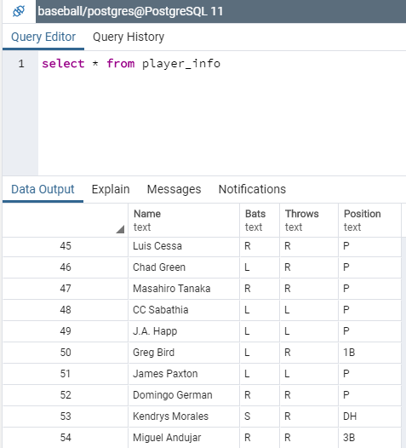
Extra
Confirmed Changed

